Slide 1



Code Inspection Document (CID)
Software Engineering 2 Project
Computer Science and Engineering (CSE)
Year 2015/16 - @PoliMi
Background Music:
Hungarian Rhapsody no.2 - F. Liszt
SE2 – Andrea Martino, Francesco Marchesani
POLITECNICO DI MILANO

Slide 2

Purpose
SE2 – Andrea Martino, Francesco Marchesani
This Code Inspection Document (CID) concerns the systematic examination of code about the release of the Glassfish 4.1 Application Server. Here we can see the steps of the SE2 project:
Here we are !!!
RASD
Deadline: 06/11/2015
Final Presentation
TBA
Testing Document
Deadline: 21/01/2016
Code Inspection Document
Deadline: 05/01/2016
Design Document
Deadline: 04/12/2015
Function Points
Deadline: 30/01/2016
POLITECNICO DI MILANO

Slide 3

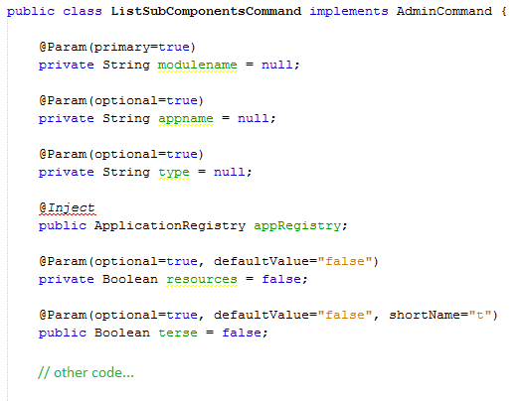
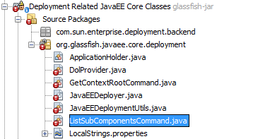
Our Class: listSubComponentsCommand
SE2 – Andrea Martino, Francesco Marchesani
Class name: ListSubComponentsCommand
Full class path:
appserver/deployment/javaee-core/src/main/java/org/glassfish/javaee/core/deployment/ListSubComponents Command.java
Implemented Interface: AdminCommand (org.glassfish.api.admin.AdminCommand)
POLITECNICO DI MILANO

Slide 4
Functional Role
SE2 – Andrea Martino, Francesco Marchesani
ListSubCompontentsCommand is an implementation of AdminCommand, an interface to provide the command list-sub-components to asadmin utility of GlassFish server.
A brief description of this command is given by GlassFish documentation:
“ The list-sub-commands subcommand lists EJBs or servlets in a deployed module or in a module of a deployed application. If a module is not specified, all modules are listed. The --appname option functions only when the specified module is standalone.
To display a specific module in an application, you must specify the module name with the --appname option. ”
POLITECNICO DI MILANO

Slide 5
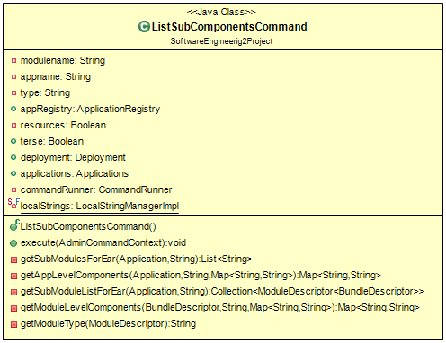
UML Representation
SE2 – Andrea Martino, Francesco Marchesani
POLITECNICO DI MILANO

Slide 6
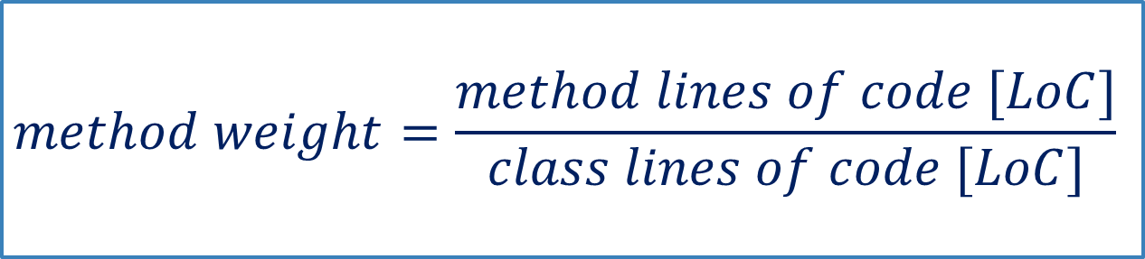
Some statistic of the class…
SE2 – Andrea Martino, Francesco Marchesani
Lines of Code [LoC]: 409 lines
execute() method length: 139 lines
getSubModulesForEar() method length: 14 lines
execute() weight in percentage: ≈ 33,99 %
getSubModulesForEar() weight in percentage: ≈ 3,42 %
Note: the first method is about ten times bigger than the second one!
$$method weight=\frac{method lines of code [LoC]}{class lines of code [LoC]}$$
POLITECNICO DI MILANO

Slide 7
Checklist Issues – Histogram
SE2 – Andrea Martino, Francesco Marchesani
POLITECNICO DI MILANO

Slide 8

In general…
SE2 – Andrea Martino, Francesco Marchesani
The code has good quality.
There are a lot of checklist points without problems.
But… we need also a Testing Phase after the Code Inspection in order to check the class in practice…
Also remember that (little excursus):
“Testing shows the presence,
not the absence of bugs “ E. Dijkstra
POLITECNICO DI MILANO

Slide 9
Little problems…
SE2 – Andrea Martino, Francesco Marchesani
Few comments!
JavaDoc is poor!
execute() is too long!
… and so on?
POLITECNICO DI MILANO

Slide 10
Suggestions…
SE2 – Andrea Martino, Francesco Marchesani
Improve the Code Documentation with more comments.
Improve the Code Documentation with better JavaDoc (pre/post conditions and so on, as seen in Software Engineering 1).
Use the “Divide et Impera” principle with execute().
… other? /* Sometimes it depends just from your tastes… this is the life! ☺ */
POLITECNICO DI MILANO

Slide 11

Thank you!!!
SE2 – Andrea Martino, Francesco Marchesani
POLITECNICO DI MILANO

